Slide 1

Setting up your ML application
Train/dev/test
sets
deeplearning.ai

Slide 2

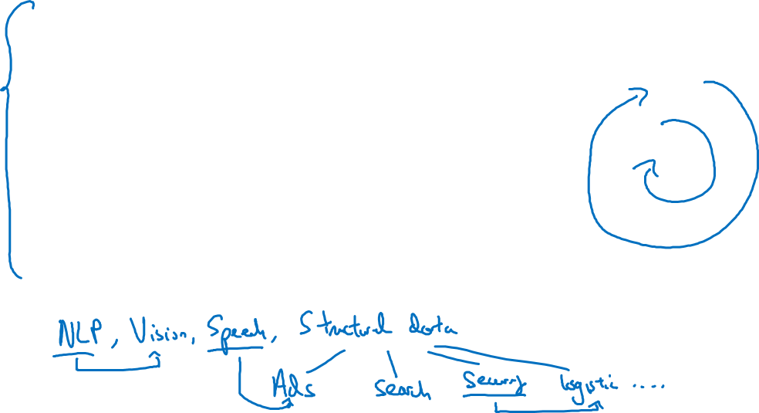
Applied ML is a highly iterative process
# layers
Idea
# hidden units
learning rates
activation functions
…
Experiment
Code

Slide 3
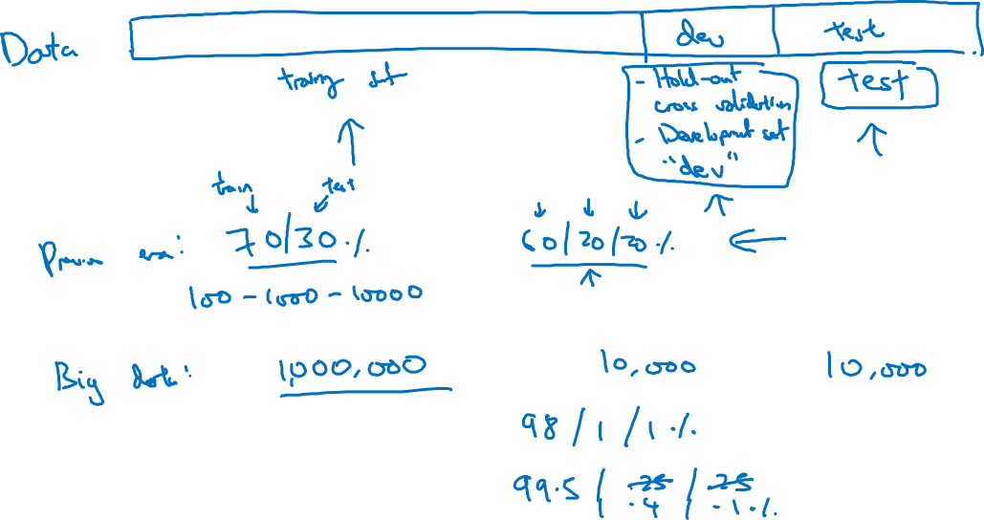
Train/dev/test sets

Slide 4
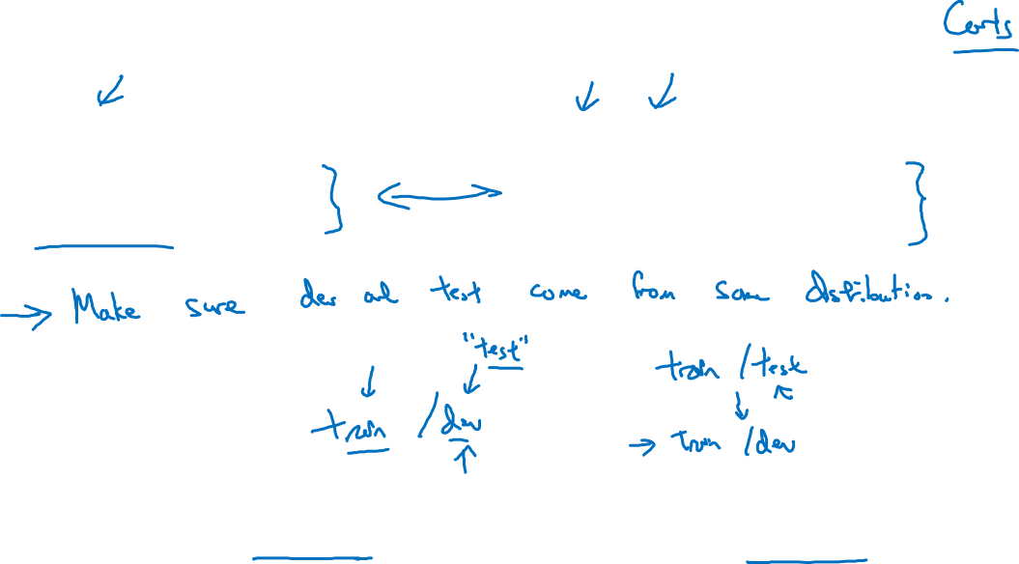
Mismatched train/test distribution
Training set:
Cat pictures from webpages
Dev/test sets:
Cat pictures from users using your app
Not having a test set might be okay. (Only dev set.)

Slide 5
Setting up your ML application
Bias/Variance
deeplearning.ai

Slide 6
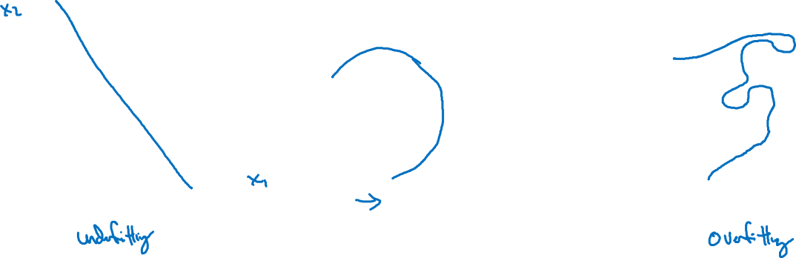
Bias and Variance
high bias
“just right”
high variance

Slide 7
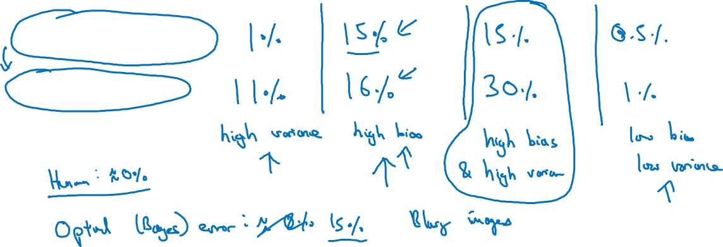
Bias and Variance
Cat classification
Train set error:
Dev set error:

Slide 8
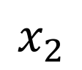
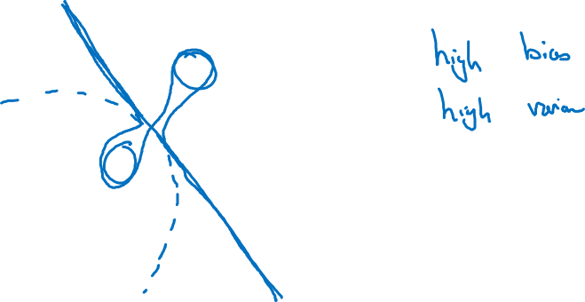
High bias and high variance
$$x_{2}$$
$$x_{1}$$

Slide 9
Setting up your ML application
Basic “recipe”
for machine learning
deeplearning.ai

Slide 10
Basic “recipe” for machine learning

Slide 11
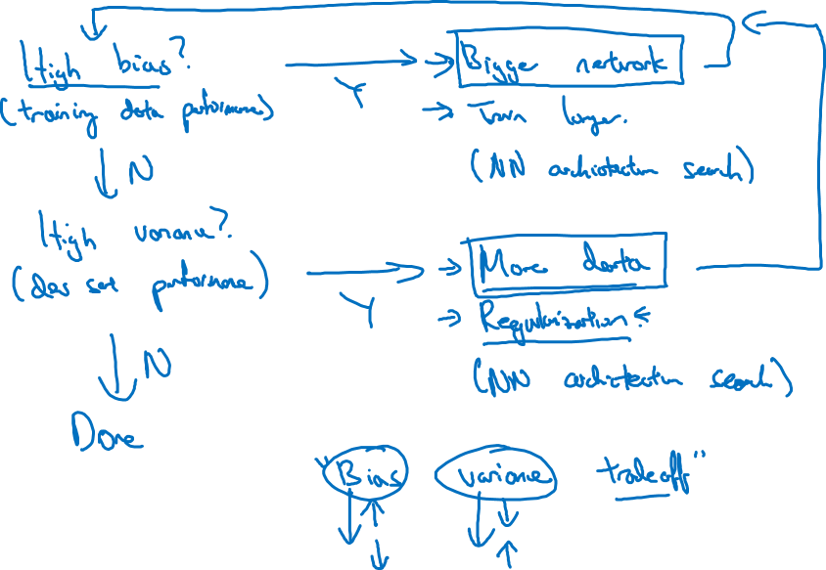
Basic recipe for machine learning

Slide 12
Regularizing your neural network
Other regularization
methods
deeplearning.ai

Slide 13

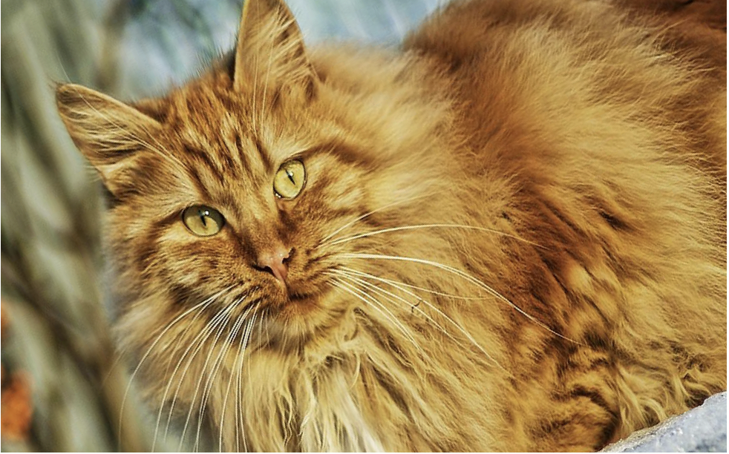


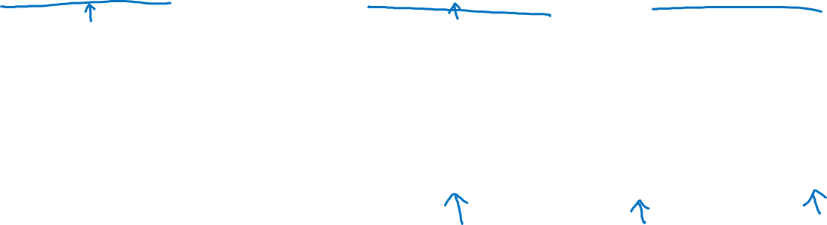
Data augmentation
4

Slide 14
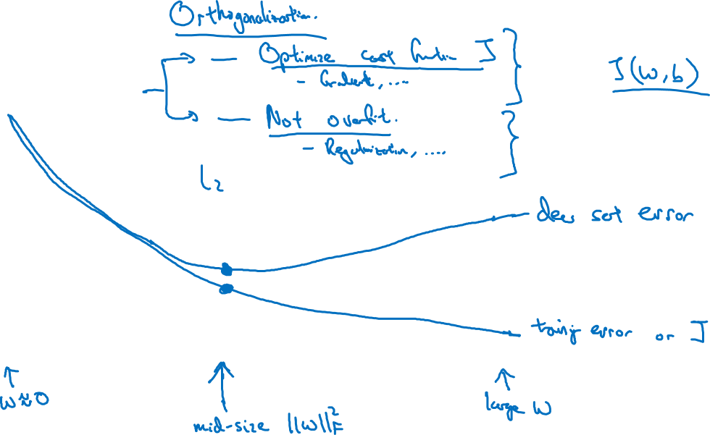
Early stopping
# iterations

Slide 15
Setting up your optimization problem
Vanishing/exploding
gradients
deeplearning.ai

Slide 16
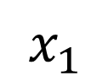
Vanishing/exploding gradients
$x_{1}$
$$\hat{y}$$
$x_{2}$
=

Slide 17
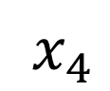
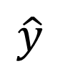
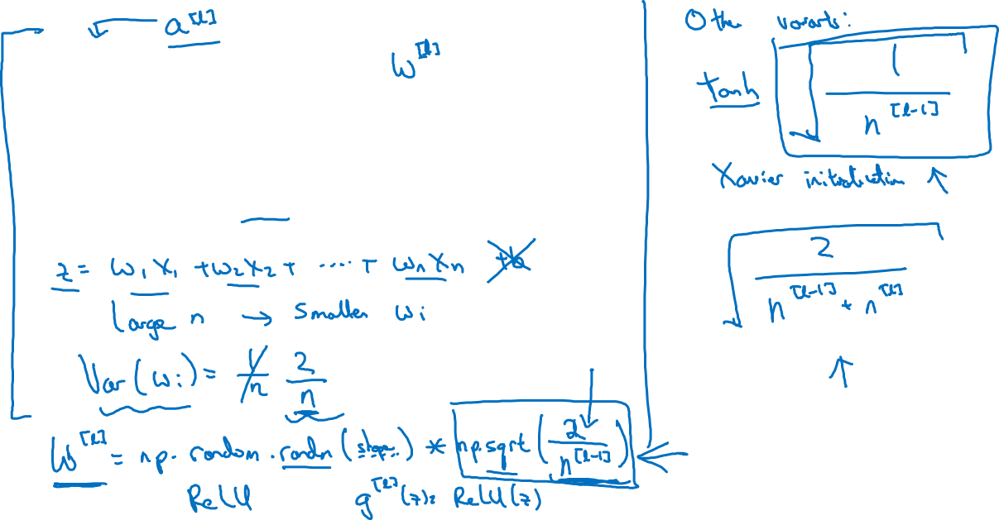
Single neuron example
$x_{1}$
$x_{2}$
$$\hat{y}$$
$x_{3}$
$x_{4}$
$$a=g(z)$$

